Slide 1
SQL Server I/O and Database Structure
Module 3

Slide 3
Learning Units covered in this Module
Lesson 1: SQL Server Page Structure
Lesson 2: SQL Server Disk I/O
Lesson 3: Troubleshooting I/O Performance
Lesson 4: SQL Server Data File Structure
Lesson 5: SQL Server TempDB File Structure
Lesson 6: SQL Server Log File Structure

Slide 4
Lesson 1: SQL Server Page Structure

Slide 5

Objectives
After completing this learning, you will be able to:
Understand the architecture of pages and extents.

Slide 6
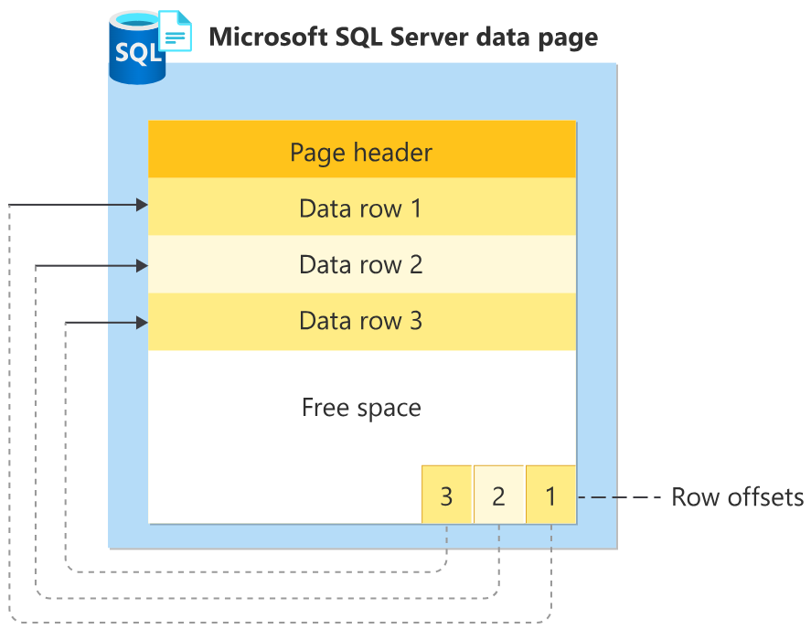
Pages and Extents architecture
A data page is the fundamental unit of data storage in SQL Server.
The disk space allocated to a data file (.mdf or .ndf) is logically divided into pages.
Each page is 8 KB in size
Pages are numbered contiguously from 0 to n.
Disk I/O operations are performed at the page level.
Extents are a collection of eight physically contiguous pages (64KB) and are used to efficiently manage the pages.
Notes:
The fundamental unit of data storage in SQL Server is the page. The disk space allocated to a data file (.mdf or .ndf) in a database is logically divided into pages numbered contiguously from 0 to n. Disk I/O operations are performed at the page level. That is, SQL Server reads or writes whole data pages.
Extents are a collection of eight physically contiguous pages and are used to efficiently manage the pages. All pages are stored in extents.
Pages
In SQL Server, the page size is 8 KB. This means SQL Server databases have 128 pages per megabyte. Each page begins with a 96-byte header that is used to store system information about the page. This information includes the page number, page type, the amount of free space on the page, and the allocation unit ID of the object that owns the page.
Page header
The page header is the first 96 bytes of each data page. It contains the page header information such as the Page ID, Page type, and Allocation Unit ID of the page.
Data rows
This section holds the actual data rows of the table. Data rows have the following characteristics:
The maximum size of a single data row is 8,060 bytes.
A normal data row cannot span multiple pages.
Text and image data columns can be stored in their own separate pages and can span multiple pages.
Fixed-length columns always store the same number of rows per page.
Variable-length rows (rows from tables that are defined by using one or more variable length data types) store as many rows as will fit, based on the actual length of the data entered.
Shorter row length enables more rows to fit on a page, thereby reducing I/O and improving the cache/hit ratio.
Row offset array
The row offset array is a block of 2-byte entries, each of which indicates the offset on the page on which the corresponding data row begins. Each row has a 2-byte entry in this array. Although these bytes are not stored in the row with the data, they do have an effect on the number of rows that will fit on a page.
The row offset array indicates the logical order of rows on a page. For example, if a table has a clustered index, the logical order is the order of the clustered index key. This does not mean that the rows will be physically stored on the page in the order of the clustered index key. Instead, slot 0 in the offset array refers to the first row in the order, slot 1 refers to the second row, and so forth. The offset of these rows can be anywhere on the page.
Additional Reading:
Pages and Extents Architecture Guide
From <https://docs.microsoft.com/en-us/sql/relational-databases/pages-and-extents-architecture-guide?view=sql-server-ver15>

Slide 7
Page types
Types | Page Type (ID) | Description
Data and Index | Data (1) | Data rows except text, ntext, image, varchar(max), nvarchar(max), varbinary(max), and xml data, when text in row is set to ON
 | Index (2) | Index Entries
 | Text/Image (3 or 4) | Large Object Data Type, variable length columns when the data row exceeds 8 kilobytes (KB)
Allocation | GAM, SGAM (8 and 9) | Extent Allocation information
 | PFS (11) | Information about page allocation and free space available on pages
 | IAM (10) | Information about extents used by a table or index per allocation unit
Restore | Bulk Changed Map (17) | Information about extents modified by bulk operations since the last BACKUP LOG statement per allocation unit
 | Differential Changed Map (16) | Information about extents that have changed since the last BACKUP DATABASE statement per allocation unit
Metadata | Boot (13) | Information about the database; Each database has only one Boot page
 | File Header (15) | Information about the file. It is the first page (page 0) in every file
Notes:
Pages
Take a regular book: all content in it is written on pages. Similar to a book, in SQL Server all the data rows are written on pages. In a book, all pages are the same physical size. Similarly, in SQL Server all data pages are the same size - 8 kilobytes. In a book most pages contain the data - the main content of the book - and some pages contain metadata about the content - for example table of contents and index. Again, SQL Server is not different: most pages contain actual rows of data which were stored by users; these are called Data pages and text/image pages (for special cases). The Index pages contain index references about where the data is and finally there are system pages that store variety of metadata about the organization of the data (PFS, GAM, SGAM, IAM, DCM, BCM pages). See table below for page types and their description.
As mentioned, in SQL Server, the page size is 8-KB. This means SQL Server databases have 128 pages per megabyte. Each page begins with a 96-byte header that is used to store system information about the page. This information includes the page number, page type, the amount of free space on the page, and the allocation unit ID of the object that owns the page.
Pages and Extents Architecture Guide
From https://docs.microsoft.com/en-us/sql/relational-databases/pages-and-extents-architecture-guide?view=sql-server-ver15

Slide 8
Row Storage
IN_ROW_DATA
LOB_DATA (For out of row storage)
ROW_OVERFLOW_DATA (SLOB)
Fixed length data must be store here.
Rows cannot extend beyond pages
Data Page is 8060 bytes
varchar(max) / nvarchar(max) / varbinary(max)
16-byte point to out of row tree
Uses text page to store a stream of data
varchar(8000) / nvarchar(4000) / varbinary(8000)
When a column can’t fit onto a page
No control over which column overflows
Notes:
Large row support
Rows can't span pages; however, portions of the row may be moved off the row's page, so the row can be very large. The maximum amount of data and overhead that is contained in a single row on a page is 8,060 bytes. This doesn't include the data stored in the text/image page type.
This restriction is relaxed for tables that contain varchar, nvarchar, varbinary, or sql_variant columns. When the total row size of all fixed and variable columns in a table exceeds the 8,060-byte limitation, SQL Server dynamically moves one or more variable length columns to pages in the ROW_OVERFLOW_DATA allocation unit, starting with the column with the largest width.
This is done whenever an insert or update operation increases the total size of the row beyond the 8,060-byte limit. When a column is moved to a page in the ROW_OVERFLOW_DATA allocation unit, a 24-byte pointer on the original page in the IN_ROW_DATA allocation unit is maintained. If a subsequent operation reduces the row size, SQL Server dynamically moves the columns back to the original data page.
If a table contains the LOB_DATA types (text, ntext, or image types), by default the actual data isn’t stored on the regular data pages. Like row-overflow data, LOB data is stored in its own set of pages, and the allocation query shows you pages for LOB data as well as pages for regular in-row data and row-overflow data. For LOB columns, SQL Server stores a 16-byte pointer in the data row that indicates where the actual data can be found. Although the default behavior is to store all the LOB data off the data row, SQL Server allows you to change the storage mechanism by setting a table option to allow LOB data to be stored in the data row itself if it is small enough. Note that no database or server setting is available to control storing small LOB columns on the data pages; it’s managed as a table option.

Slide 9
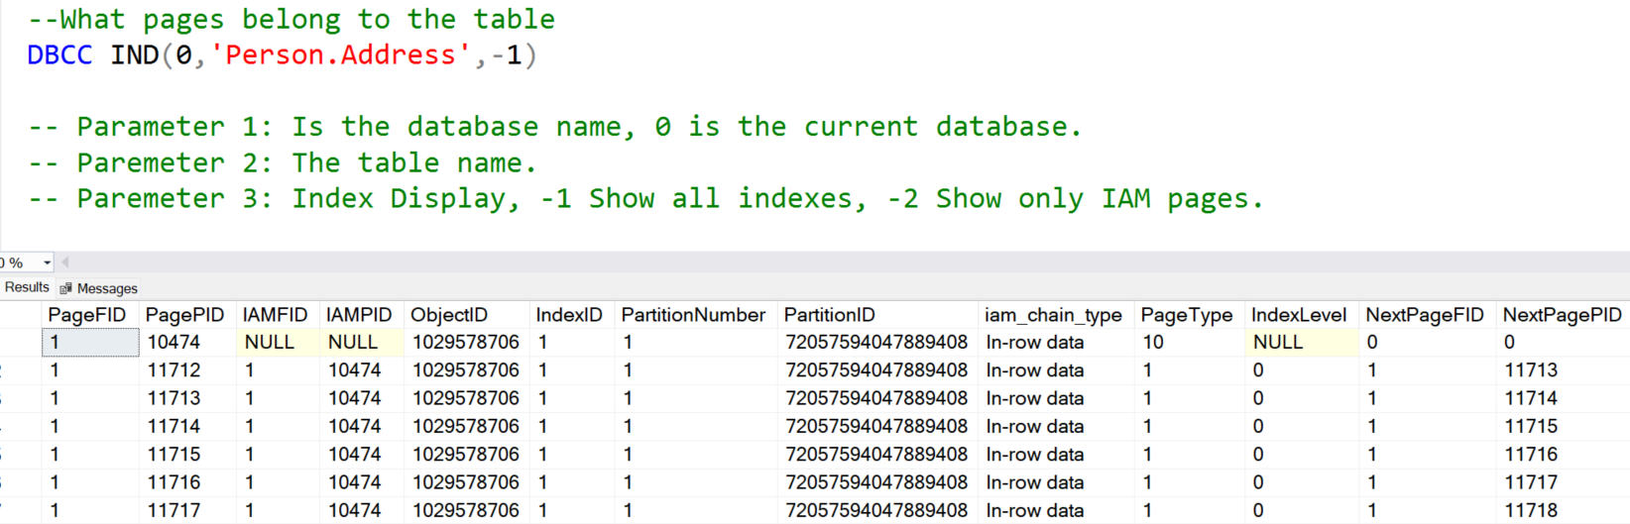
DBCC IND
Notes:
Investigating Page Contents Using DBCC Commands
We can use the following undocumented DBCC commands to take a look inside our data and index pages: DBCC IND, DBCC TRACEON, and DBCC PAGE.
DBCC IND provides the relevant page IDs for any object in the database, and then DBCC PAGE allows us to investigate what’s stored on disk on those specific pages. Note that DBCC PAGE and DBCC IND are both ready-only operations, so they’re completely safe to use.
DBCC TRACEON(3604) is used prior to the DBCC PAGE command so that the results are printed to the results pane.

Slide 10
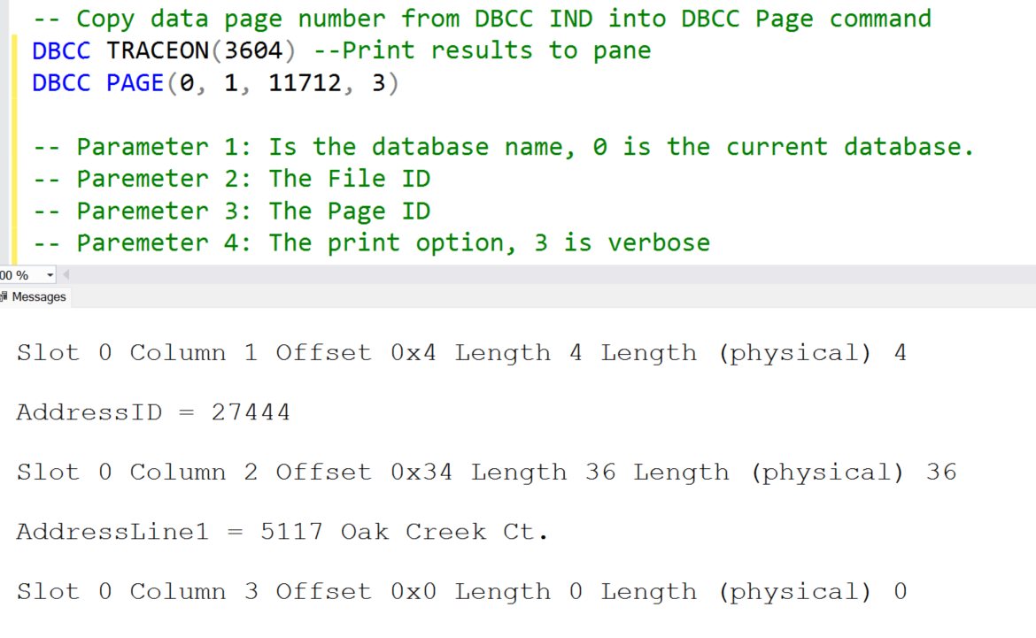
DBCC PAGE
Notes:
Investigating Page Contents Using DBCC Commands
We can use the following undocumented DBCC commands to take a look inside our data and index pages: DBCC IND, DBCC TRACEON, and DBCC PAGE.
DBCC IND provides the relevant page IDs for any object in the database, and then DBCC PAGE allows us to investigate what’s stored on disk on those specific pages. Note that DBCC PAGE and DBCC IND are both ready-only operations, so they’re completely safe to use.
DBCC TRACEON(3604) is used prior to the DBCC PAGE command so that the results are printed to the results pane.

Slide 11
New DMF ( SQL Server 2019 and later)
sys.dm_db_page_info
Returns information about a page in a database.
The function returns one row that contains the header information from the page, including the object_id, index_id, and partition_id.
This function replaces the need to use DBCC PAGE in most cases.
Output sample:
sys.dm_db_page_info is currently supported only in SQL Server 2019 (15.x) and later.
Notes:
Further Reading: https://learn.microsoft.com/en-us/sql/relational-databases/system-dynamic-management-views/sys-dm-db-page-info-transact-sql?view=sql-server-ver16
sys.dm_db_page_info can be used in place of the DBCC PAGE statement in many cases, but it returns only the page header information, not the body of the page. DBCC PAGE will still be needed for use cases where the entire contents of the page are required.

Slide 12

Demonstration
Examining Data Pages
Notes:
Demo files used in the older version of the Workshop releases are retained in E:\Archived (this is for any reference)
You can open all the demonstrations by using the solutions file :
E:\Demos\SQL_PTO_Workshop_Demos.ssmssln
Individual SQL demo file.
E:\Demos\03_Database_Structure\ExaminingDataPages
E:\Demos\03_Database_Structure\ExaminingDataPages_RowOverFlow

Slide 13
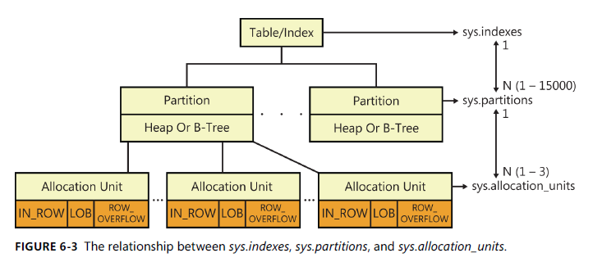
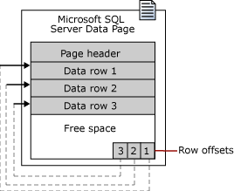
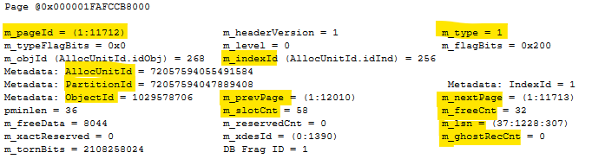
Examining Data Pages
For the first demo the sys.dm_db_database_page_allocations DMVs will help to understand the different page types inside of a database.
sys.dm_db_database_page_allocations
DBCC Page show the different elements that composes a page.

Slide 14
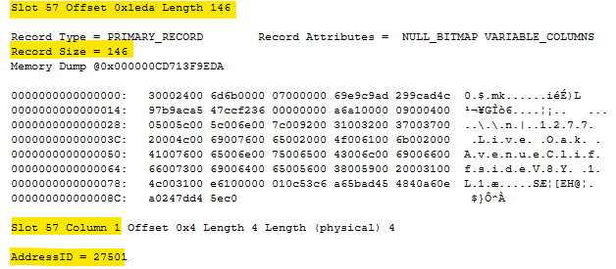
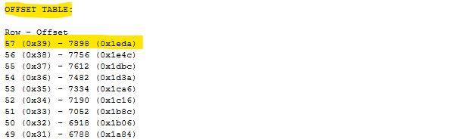
Examining Data Pages

Slide 15
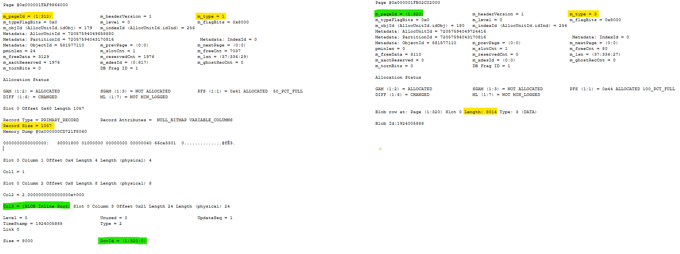
Examining Data Pages
The second demo shows how SQL Server will create a new extent with ROW_OVERFLOW_DATA pages, review how those are linked with the IAM pages and IN_ROW_DATA pages.
IN_ROW_DATA
ROW_OVERFLOW_DATA

Slide 16

Questions?

Slide 17
Knowledge Check
What is the size of a data page?
What is an extent?
What are different page types?
What is a row overflow?
Notes:
Q1) What is the size of a data page
A1) 8KB
Q2) What is an extent?
A2) Extents are a collection of eight physically contiguous pages (64KB) and are used to efficiently manage the pages.
Q3) What are different page types?
A3)
DATA
INDEX
TEXT/IMGE
GAM, SGAM
PFS,
IAM
BCM
DCM
Boot
File Header
Q4) What is a row overflow?
A4) When the total row size of all fixed and variable columns in a table exceeds the 8,060 byte limitation, SQL Server dynamically moves one or more variable length columns to pages in the ROW_OVERFLOW_DATA allocation unit, starting with the column with the largest width.

Slide 18
Lesson 2: SQL Server Disk I/O

Slide 19
Objectives
After completing this learning, you will be able to:
Identify SQL Server disk I/O operations.
Identify I/O patterns for data files and log files.
Monitor SQL Server I/O using:
Performance Monitor Counters
Dynamic Management Views
Wait Statistics

Slide 20
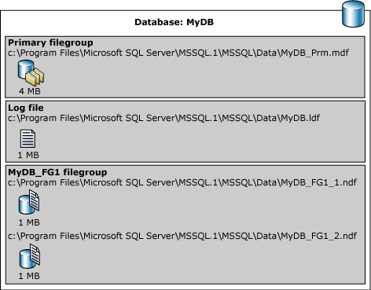
Database files and filegroups
Database files
A database is composed by at least two operating system files:
Data files
Contain database objects and data
Can be grouped together in filegroups for allocation and administration purposes
Log file
A database may have additional data files, known as secondary data files. They use .ndf extension
Contain Log Records and entries are sequenced
First data file is called primary data file. This file has a .mdf extension
Notes:
At a minimum, every SQL Server database has two operating system files: a data file and a log file. Data files contain data and objects such as tables, indexes, stored procedures, and views. Log files contain the information that is required to recover all transactions in the database. Data files can be grouped together in filegroups for allocation and administration purposes.
Database Files
SQL Server databases have three types of files:
Primary
The primary data file contains the startup information for the database and points to the other files in the database. User data and objects can be stored in this file or in secondary data files. Every database has one primary data file. The recommended file name extension for primary data files is .mdf.
Secondary
Secondary data files are optional, are user-defined, and store user data. Secondary files can be used to spread data across multiple disks by putting each file on a different disk drive. Additionally, if a database exceeds the maximum size for a single Windows file, you can use secondary data files so the database can continue to grow. The recommended file name extension for secondary data files is .ndf.Transaction
Log
The transaction log files hold the log information that is used to recover the database. There must be at least one log file for each database. The recommended file name extension for transaction logs is .ldf.
Database Files and Filegroups
From <https://docs.microsoft.com/en-us/sql/relational-databases/databases/database-files-and-filegroups?view=sql-server-ver15>

Slide 21
SQL Server disk I/O patterns:
Data Files
May have one or more .ndf file
Random reads and writes
Write activity during checkpoints, recovery, and lazy writes
One .mdf file per database
Read activity during backups; other activity varies depending on query activity and buffer pool size
Log Files
One .ldf file per database
Sequential reads and writes
Write activity during the log buffer flush operations
Read activity during checkpoints, backups, and recovery
Features such as Always On Availability Groups and replication will increase read and write activity
Notes:
It is possible to have more than one log file per database, but it is not recommended. As Log files are accessed sequentially (for both read and write operations), multiple log files will not provide any performance benefit.

Slide 22
Database files and filegroups
Types of filegroups
Primary filegroup
User-defined filegroup
Memory optimized data filegroup
FILESTREAM file group
Notes:
There are different types of filegroups:
Primary filegroup
Every database has a primary filegroup which contains the primary data file and any secondary files that are not put into other filegroups.
User-defined filegroup
Can be created to group data files together for administrative, data allocation, and placement purposes.
Memory optimized data filegroup
The memory-optimized filegroup is required to create memory-optimized tables.
FILESTREAM file group
FILESTREAM enables SQL Server-based applications to store unstructured data, such as documents and images, on the file system.
A FILESTREAM filegroup is a special filegroup that contains file system directories instead of the files themselves. These file system directories are called data containers. Data containers are the interface between Database Engine storage and file system storage.
Database Files and Filegroups
From <https://docs.microsoft.com/en-us/sql/relational-databases/databases/database-files-and-filegroups?view=sql-server-ver15>

Slide 23
SQL Server disk I/O
Database page reads and writes always go through the buffer pool.
With disk-based table operations, SQL Server uses Write-Ahead logging to adhere to ACID principles.
Data modification statement is sent by an application.
2
Modification is recorded in the log cache.
1
4
Log cache record is flushed to the transaction log.
Buffer cache
Transaction log
Data file
5
Dirty pages are written to disk.
3
The affected data pages are located in, or read into, the buffer cache and modified.
Notes:
This section describes the role of the write-ahead transaction log in recording data modifications to disk. SQL Server uses a write-ahead logging (WAL) algorithm, which guarantees that no data modifications are written to disk before the associated log record is written to disk. This maintains the ACID properties for a transaction.
To understand how the write-ahead log works, it is important for you to know how modified data is written to disk. SQL Server maintains a buffer cache into which it reads data pages when data must be retrieved. When a page is modified in the buffer cache, it is not immediately written back to disk; instead, the page is marked as dirty. A data page can have more than one logical write made before it is physically written to disk. For each logical write, a transaction log record is inserted in the log cache that records the modification. The log records must be written to disk before the associated dirty page is removed from the buffer cache and written to disk. The checkpoint process periodically scans the buffer cache for buffers with pages from a specified database and writes all dirty pages to disk. Checkpoints save time during a later recovery by creating a point at which all dirty pages are guaranteed to have been written to disk.
Writing a modified data page from the buffer cache to disk is called flushing the page. SQL Server has logic that prevents a dirty page from being flushed before the associated log record is written. Log records are written to disk when the log buffers are flushed. This happens whenever a transaction commits or the log buffers become full.
Key Points:
SQL Server uses the buffer pool to minimize the amount of disk I/O that must be done against the data file. When a page is required for a read or write operation, the buffer pool is checked first. If the page is already in the buffer pool, the operation can be satisfied from memory only.
When a modification happens, the change is made to the data page in memory first, and then a log record is written to the transaction log file. The page will not be written out to disk until the CHECKPOINT process comes through and flushes changes out to the data file. If the SQL Server process is shut down unexpectedly and the memory space is lost, SQL Server uses the transaction log to bring the data file up to date with any changes that were committed before the crash but not persisted to disk. This is called recovery.
To optimize the I/O, SQL Server will attempt to gather pages together so that larger chunks of a file can be read or written in a single operation. For reads, SQL Server has a read ahead mechanism that will read contiguous pages from an object in a single request if needed by a query. For writes, SQL Server will gather together a chunk of contiguous pages that have been modified so they can be written in a single request.
Additional Reading:
SQL Server Transaction Log Architecture and Management Guide
From <https://docs.microsoft.com/en-us/sql/relational-databases/sql-server-transaction-log-architecture-and-management-guide?view=sql-server-ver15>
ACID properties
From <https://docs.microsoft.com/en-us/previous-versions/office/developer/server-technologies/aa480356(v=msdn.10)>
Write-Ahead Transaction Log
From <https://docs.microsoft.com/en-us/sql/relational-databases/sql-server-transaction-log-architecture-and-management-guide?view=sql-server-ver15#WAL>
Writing Pages
From <https://docs.microsoft.com/en-us/sql/relational-databases/writing-pages?view=sql-server-ver15>
Analyzing I/O Characteristics and Sizing Storage Systems for SQL Server Database Applications
From <https://docs.microsoft.com/en-us/previous-versions/sql/sql-server-2008/ee410782(v=sql.100)>

Slide 24
SQL Server Buffer Pool
Stores 8 kilobytes (KB) pages of data to avoid repeated disk I/O.
Pages held in the buffer until the space is needed by something else.
Physical
Read
Logical
Read
Buffer Pool
Memory
Disks
Notes:
Key Points:
The buffer pool generally represents the largest percentage of SQL Server memory. In NUMA systems, there will be a separate buffer pool node for each NUMA node.
The buffer pool abstracts the physical location of data and provides caching functions. All data accessed by SQL Server goes through the buffer pool. Therefore, the buffer pool can determine the data that should be stored in the cache to boost performance for frequently used objects.
There are two ways that the data is accessed from the buffer pool:
Logical read. Indicates that the data requested is already present in the cache. A logical read-only involves memory access, so the response time is optimum.
Physical read. Indicates that the data requested is not present in the cache, so the data must be found by using the database files. A physical read is a disk I/O operation, which is more expensive than memory access. When the I/O operation completes, the request is satisfied and the data is stored in the cache so that it can be accessed later.
When a query runs, the database pages that contain the data required to return the query result may or may not be located in physical memory. The query does not have the notion of data locality; it simply requests the page from the buffer pool.
If the pages are in memory, then there is a logical read of the page, which results in a cache hit. If the page is not in memory, then there needs to be a physical read of the page from the disk subsystem. This results in a cache miss event.
Additional Reading:
Buffer Management
https://docs.microsoft.com/en-us/previous-versions/sql/sql-server-2008-r2/aa337525(v=sql.105)
Growing and Shrinking the Buffer Pool Under NUMA
https://docs.microsoft.com/en-us/previous-versions/sql/sql-server-2008-r2/ms345403(v=sql.105)

Slide 25
Log Buffer Flushing
SQL Server will flush the log buffer to the log file
SQL Server gets a commit request of a transaction that changes data.
The log buffer fills up. (Max size 60kb.)
SQL Server needs to harden dirty data pages (checkpoints)
Manually request a log buffer flush using the sys.sp_flush_log procedure
Log buffer flushing results in a WRITELOG wait type.

Slide 26
Checkpoints
Flushes dirty pages from the buffer pool to the disk. Frequency of checkpoints varies based on the database activity and recovery interval.
Automatic (default) – Database engine issues checkpoints automatically based on the server level “recovery interval” configuration option
Indirect (new from SQL Server 2012 onwards) – Database engine issues checkpoints automatically based on the database level TARGET_RECOVERY_TIME
Manual – Issued in the current database for your connection when you execute the T-SQL CHECKPOINT command
Internal – Issued by various server operations
ALTER DATABASE [AdventureWorksPTO] SET TARGET_RECOVERY_TIME = 60 SECONDS
Notes:
Overview
For performance reasons, the Database Engine performs modifications to database pages in memory-in the buffer cache-and does not write these pages to disk after every change. Rather, the Database Engine periodically issues a checkpoint on each database. A checkpoint writes the current in-memory modified pages (known as dirty pages) and transaction log information from memory to disk and, also records the information in the transaction log.
The Database Engine supports several types of checkpoints: automatic, indirect, manual, and internal.
Note
The -k SQL Server advanced setup option enables a database administrator to throttle checkpoint I/O behavior based on the throughput of the I/O subsystem for some types of checkpoints. The -k setup option applies to automatic checkpoints and any otherwise unthrottled manual and internal checkpoints.
For automatic, manual, and internal checkpoints, only modifications made after the latest checkpoint need to be rolled forward during database recovery. This reduces the time required to recover a database.
Important
Long-running, uncommitted transactions increase recovery time for all checkpoint types.
Key Points:
Checkpoints are used by the database engine to minimize the time to recover databases in the event of a server crash or restart. Data page changes are buffered in memory to minimize disk I/O and maximize performance. If the server crashes, any changes made in-memory that have not yet been written to the data file will be lost. Upon restart, SQL Server will need to recover these changes by reading the transaction log file – rolling forward any changes that were committed at the time of the crash and rolling back any changes that were not committed at the time of the crash. This process is called “recovery.”
The “recovery interval” server option allows you to control the estimated time it will take to recover databases on the server upon restart. The default setting is 0, which allows SQL Server to control the interval (typically resulting in checkpoints about every 1 minute and < 1 minute recovery). The longer the recovery interval, the less frequent the checkpoints will be, resulting in less disk I/O on the server. The tradeoff is longer recovery time, thus longer downtime in the event of an unexpected restart. It is recommended to leave the recovery interval at the default, but if there are very frequent changes in a database, particularly changes that always affect the same page in memory, it may be beneficial to increase the interval.
Additional Reading:
Database Checkpoints (SQL Server)
From <https://docs.microsoft.com/en-us/sql/relational-databases/logs/database-checkpoints-sql-server?view=sql-server-ver15>
Configure the recovery interval Server Configuration Option
From <https://docs.microsoft.com/en-us/sql/database-engine/configure-windows/configure-the-recovery-interval-server-configuration-option?view=sql-server-ver15>
Change the Target Recovery Time of a Database (SQL Server)
From <https://docs.microsoft.com/en-us/sql/relational-databases/logs/change-the-target-recovery-time-of-a-database-sql-server?view=sql-server-ver15>

Slide 27
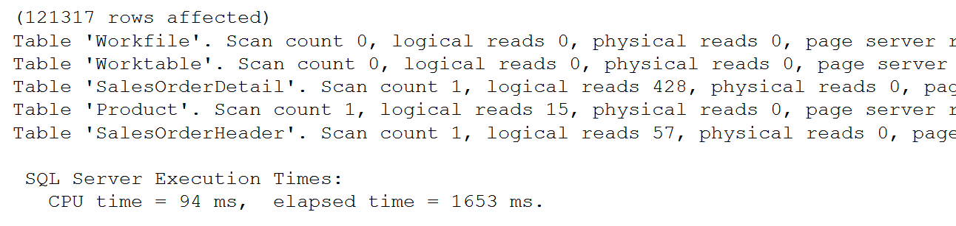
SET STATISTICS IO
SET STATISTICS IO ON
GO
SET STATISTICS TIME ON
SELECT SOH.SalesOrderID, SOH.CustomerID,
OrderQty, UnitPrice, P.Name
FROM Sales.SalesOrderHeader AS SOH
JOIN Sales.SalesOrderDetail AS SOD
ON SOH.SalesOrderID = SOD.SalesOrderID
JOIN Production.Product AS P
ON P.ProductID = SOD.ProductID
SET STATISTICS IO, TIME OFF
Used to identify physical reads and logical reads for a query
Notes:
https://learn.microsoft.com/en-us/sql/t-sql/statements/set-statistics-io-transact-sql?view=sql-server-ver16
Causes SQL Server to display information about the amount of disk activity generated by Transact-SQL statements.
https://learn.microsoft.com/en-us/sql/t-sql/statements/set-statistics-time-transact-sql?view=sql-server-ver16
Displays the number of milliseconds required to parse, compile, and execute each statement.

Slide 28
Total Query Response Time
The full cycle between the several task states, for how many times it needs to cycle, is what we experience as the total query response time.
CPU Time (RUNNING)
Total Query Response Time
Signal Wait Time (RUNNABLE)
Resource Wait Time (SUSPENDED)

Slide 29
Demonstration
Using SET STATISTICS IO and SET STATISTICS TIME to identify Logical Reads vs Physical Reads.
Notes:
Demo files used in the older version of the Workshop releases are retained in E:\Archived (this is for any reference)
You can open all the demonstrations by using the solutions file :
E:\Demos\SQL_PTO_Workshop_Demos.ssmssln
Individual SQL demo file.
E:\Demos\03_Database_Structure\Display_Statiistics.sql

Slide 30
Notable Waits
PAGE access related waits
PAGELATCH_xx
PAGEIOLATCH_xx
Indicates contention for access to buffers (in-memory copies of pages).
Indicates I/O problems in data pages.
If PFS, SGAM, and GAM then it is allocation contention (updating allocation metadata), namely in TempDB.
Validate disk and memory perfmon counters and the SQL Errorlogs (for error 833 “I/O taking longer than 15 seconds”).
Examine the virtual file stats DMV.
Waiting for a log flush to disk
Examine the I/O latency for the log file
WRITELOG
Notes:
LATCH_xx = Indicates contention for access to some non-page structures. ACCESS_METHODS_DATASET_PARENT, ACCESS_METHODS_SCAN_RANGE_GENERATOR or NESTING_TRANSACTION_FULL latches indicate parallelism issues;
We will talk more about Latching in Module 6.
PAGELATCH_xx = Indicates contention for access to Buffers (in-memory copies of pages) such as PFS, SGAM, and GAM.
PAGELATCH_UP = Does the filegroup have enough files? Contention in PFS?
PAGELATCH_EX = Contention while doing many UPDATE statements against small tables? Many concurrent INSERT statements into a table that has an index on an IDENTITY or NEWSEQUENTIALID column?
PAGEIOLATCH_xx = Indicates I/O problems. Validate disk and memory perfmon counters, virtual file stats DMV, and the SQL Errorlogs (for error 833 “I/O taking longer than 15 seconds”).
Consider replacing all the “=“ symbols with a colon :
Define PFS, GAM and SGAM at the first instance

Slide 31
Lesson 3: Troubleshooting I/O Performance

Slide 32
Objectives
After completing this learning, you will be able to:
Review Wait Types related to I/O
Troubleshoot I/O bottleneck

Slide 33
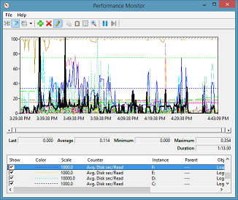
Disk I/O monitoring and troubleshooting
Disk Performance Counters
Disk Reads/sec, Writes/sec and Transfers/sec
Indicates the IOPS (Input/Output Operations Per Second) as perceived by the operating system. This value could differ from the hardware IOPS.
Avg. Disk sec/Read, and Avg. Disk sec/Write
Used to measure IO latency
< .005 excellent; .005 - .010 Good; .010 - .015 Fair; > .015 investigate
Notes:
Disk Transfers/sec: It is the rate of read and write operations on the disk and is the number of IO operations per second (IOPS) according to the operating system. If hardware redundant array of inexpensive disks (RAID) is used, then keep in mind that the hardware IOPS will be different. For example, hardware RAID1 (mirror set) will have hardware IOPS of (1 x Read) + (2 x Write).
Troubleshooting Slow Disk I/O in SQL Server
From <https://docs.microsoft.com/en-us/archive/blogs/askjay/troubleshooting-slow-disk-io-in-sql-server>
Measuring Disk Latency with Windows Performance Monitor (Perfmon)
From <https://docs.microsoft.com/en-us/archive/blogs/askcore/measuring-disk-latency-with-windows-performance-monitor-perfmon>
Disk Transfers/sec (Disk Reads/sec, Disk Writes/sec) Perfmon captures the total number of individual disk IO requests completed over a period of one second. If the Perfmon capture interval is set for anything greater than one second, the average of the values captured is presented. Disk Reads/sec and Disk Writes/sec are calculated in the same way, but break down the results in read requests only or write requests only, respectively.
Disk Bytes/sec (Disk Read Bytes/sec, Disk Write Bytes/sec) Perfmon captures the total number of bytes sent to the disk (write) and retrieved from the disk (read) over a period of one second. If the Perfmon capture interval is set for anything greater than one second, the average of the values captured is presented. The Disk Read Bytes/sec and the Disk Write Bytes/sec counters break down the results displaying only read bytes or only write bytes, respectively.
Avg. Disk Bytes/Transfer (Avg. Disk Bytes/Read, Avg. Disk Bytes/Write) Displays the average size of the individual disk requests (IO size) in bytes, for the capture interval. Example: If the system had ninety nine IO requests of 8K and one IO request of 2048K, the average will be 28.4K. Calculation = (8k*99) + (1*2048k) / 100 The Avg. Disk Bytes/Read and Avg. Disk Bytes/Write counters break down the results showing the average size for only read requests or only write requests, respectively.
Avg. Disk sec/Transfer (Avg. Disk sec/Read, Avg. Disk sec/Write) Displays the average time the disk transfers took to complete, in seconds. Although the scale is seconds, the counter has millisecond precision, meaning a value of 0.004 indicates the average time for disk transfers to complete was 4 milliseconds. This is the counter in Perfmon used to measure IO latency.
Additional Reading:
Windows Performance Monitor Disk Counters Explained
From <https://docs.microsoft.com/en-us/archive/blogs/askcore/windows-performance-monitor-disk-counters-explained>
Slow I/O - SQL Server and disk I/O performance
From <https://techcommunity.microsoft.com/t5/sql-server-support/slow-i-o-sql-server-and-disk-i-o-performance/ba-p/333983>

Slide 34
Disk I/O monitoring and troubleshooting
Disk Performance Counters
Logical Disk: Avg. Disk Sec/Read and Avg. Disk Sec/Write
Less than 10 milliseconds (ms) = Very Good
Between 10-20 ms = Fair
Between 20-50 ms = Poor, needs attention
Greater than 50 ms = Serious I/O bottleneck
Logical Disk: Avg. Disk Bytes/Transfer for knowledge on I/O sizes
Logical Disk: Disk Transfers/sec for knowledge on IOPS
Notes:
Key Points:
Average Disk sec/read, Average Disk sec/write - The average time, in seconds, of a read/write of data from/to the disk. Use the following to analyze numbers in the output.
- Less than 8 milliseconds (ms) = Very Good
- Between 9-12 ms = Fair
- Between 13-20 ms = Poor, needs attention
- Greater than 20 ms = Serious I/O bottleneck
Calculate I/Os per disk:
Raid 0 -> (reads + writes) / number of disks
Raid 1 -> [reads + (2 * writes)] / 2
Raid 5 -> [reads + (4 * writes)] / number of disks
Raid 10 -> [reads + (2 * writes)] / number of disks
With RAID 1 or 10, each write is duplicated onto a mirrored drive. Hence, there are two-disk writes/sec.
With RAID 5, each write generates four I/O operations: reading the data block, reading the parity block, writing the data block, and writing the parity block. Hence there are four disk writes/sec.
Additional Reading:
Disk Performance Internals
From <https://docs.microsoft.com/en-us/archive/blogs/ntdebugging/disk-performance-internals>
Troubleshooting Performance Problems in SQL Server 2008
From <https://docs.microsoft.com/en-us/previous-versions/sql/sql-server-2008/dd672789(v=sql.100)?redirectedfrom=MSDN>

Slide 35
Disk I/O monitoring and troubleshooting
Notable wait types
ASYNC_IO_COMPLETION
IO_COMPLETION
LOGMGR
WRITELOG
Occurs when a task is waiting for I/O to finish
Generally, represents non-data page I/O
Occurs when a task is waiting for any outstanding log I/O to finish, before shutting down the log to close the database.
Occurs while waiting for a log flush to complete. Common operations that cause log flush are checkpoints and transaction commits.
PAGEIOLATCH_xx
Indicates I/O problems in data pages
Validate disk and memory perfmon counters and the SQL Errorlogs (for error 833 “I/O taking longer than 15 seconds”)
Examine the virtual file stats DMV
Notes:
sys.dm_os_wait_stats Top wait statistics in sys.dm_os_wait_stats that are related to I/O.
PAGELATCH_xx = Indicates contention for access to Buffers (in-memory copies of pages) such as PFS, SGAM, and GAM.
PAGELATCH_UP = Does the filegroup have enough files? Contention in PFS?
PAGELATCH_EX = Contention while doing many UPDATE statements against small tables? Many concurrent INSERT statements into a table that has an index on an IDENTITY or NEWSEQUENTIALID column?
PAGEIOLATCH_xx = Indicates I/O problems. Validate disk and memory perfmon counters, virtual file stats DMV, and the SQL Errorlogs (for error 833 “I/O taking longer than 15 seconds”)
Additional Reading:
sys.dm_os_wait_stats (Transact-SQL)
From <https://docs.microsoft.com/en-us/sql/relational-databases/system-dynamic-management-views/sys-dm-os-wait-stats-transact-sql?view=sql-server-ver15#see-also>
tigertoolbox/Waits-and-Latches/
From <https://github.com/Microsoft/tigertoolbox/tree/master/Waits-and-Latches>

Slide 36
Disk I/O monitoring and troubleshooting
Pending I/O DMV
sys.dm_io_pending_io_requests
Returns a row for each in-flight pending I/O request:
Disk
Network
Notes:
Additional Reading:
sys.dm_io_pending_io_requests (Transact-SQL)
From <https://docs.microsoft.com/en-us/sql/relational-databases/system-dynamic-management-views/sys-dm-io-pending-io-requests-transact-sql?view=sql-server-ver15>
How It Works: sys.dm_io_pending_io_requests
From <https://techcommunity.microsoft.com/t5/sql-server-support/how-it-works-sys-dm-io-pending-io-requests/ba-p/316800>
View pending IO:
SELECT iop.io_type, iop.io_pending, iop.io_pending_ms_ticks, iop.io_completion_request_address, iop.io_handle, iop.scheduler_address, DB_NAME(vfs.database_id) AS database_name,
smf.name AS logical_filename, smf.physical_name AS physical_filename,
vfs.io_stall_read_ms, vfs.io_stall_write_ms, vfs.io_stall
FROM sys.dm_io_pending_io_requests iop
INNER JOIN sys.dm_io_virtual_file_stats(NULL, NULL) vfs ON iop.io_handle = vfs.file_handle
INNER JOIN sys.master_files smf ON vfs.database_id = smf.database_id AND vfs.file_id = smf.file_id
GO

Slide 37
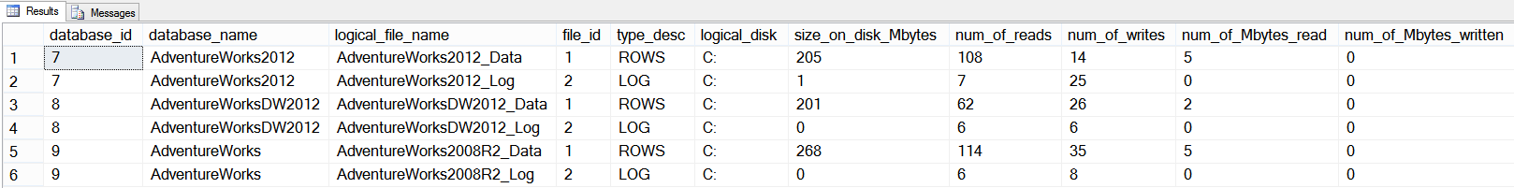
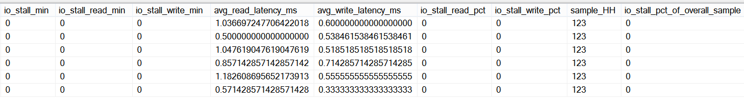
Disk I/O monitoring and troubleshooting
I/O Per File DMV
sys.dm_io_virtual_file_stats
Returns I/O statistics for data and log files since the respective file was first attached to SQL Server.
Notes:
Additional Reading:
sys.dm_io_virtual_file_stats (Transact-SQL)
From <https://docs.microsoft.com/en-us/sql/relational-databases/system-dynamic-management-views/sys-dm-io-virtual-file-stats-transact-sql?view=sql-server-ver15>
View virtual file stats:
SELECT f.database_id, DB_NAME(f.database_id) AS database_name, f.name AS logical_file_name, f.[file_id], f.type_desc,
CAST (CASE
-- Handle UNC paths (e.g. '\\fileserver\readonlydbs\dept_dw.ndf')
WHEN LEFT (LTRIM (f.physical_name), 2) = '\\'
THEN LEFT (LTRIM (f.physical_name),CHARINDEX('\',LTRIM(f.physical_name),CHARINDEX('\',LTRIM(f.physical_name), 3) + 1) - 1)
-- Handle local paths (e.g. 'C:\Program Files\...\master.mdf')
WHEN CHARINDEX('\', LTRIM(f.physical_name), 3) > 0
THEN UPPER(LEFT(LTRIM(f.physical_name), CHARINDEX ('\', LTRIM(f.physical_name), 3) - 1))
ELSE f.physical_name
END AS NVARCHAR(255)) AS logical_disk,
fs.size_on_disk_bytes/1024/1024 AS size_on_disk_Mbytes,
fs.num_of_reads, fs.num_of_writes,
fs.num_of_bytes_read/1024/1024 AS num_of_Mbytes_read,
fs.num_of_bytes_written/1024/1024 AS num_of_Mbytes_written,
fs.io_stall/1000/60 AS io_stall_min,
fs.io_stall_read_ms/1000/60 AS io_stall_read_min,
fs.io_stall_write_ms/1000/60 AS io_stall_write_min,
(fs.io_stall_read_ms / (1.0 + fs.num_of_reads)) AS avg_read_latency_ms,
(fs.io_stall_write_ms / (1.0 + fs.num_of_writes)) AS avg_write_latency_ms,
((fs.io_stall_read_ms/1000/60)*100)/(CASE WHEN fs.io_stall/1000/60 = 0 THEN 1 ELSE fs.io_stall/1000/60 END) AS io_stall_read_pct,
((fs.io_stall_write_ms/1000/60)*100)/(CASE WHEN fs.io_stall/1000/60 = 0 THEN 1 ELSE fs.io_stall/1000/60 END) AS io_stall_write_pct,
ABS((sample_ms/1000)/60/60) AS 'sample_HH',
((fs.io_stall/1000/60)*100)/(ABS((sample_ms/1000)/60)) AS 'io_stall_pct_of_overall_sample'.
FROM sys.dm_io_virtual_file_stats (default, default) AS fs
INNER JOIN sys.master_files AS f ON fs.database_id = f.database_id AND fs.[file_id] = f.[file_id]
ORDER BY 18 DESC GO

Slide 38
Demonstration
Monitoring and troubleshooting Disk I/O
Notes:
Demo files used in the older version of the Workshop releases are retained in E:\Archived (this is for any reference)
You can open all the demonstrations by using the solutions file :
E:\Demos\SQL_PTO_Workshop_Demos.ssmssln
Individual SQL demo file.
E:\Demos\03_Database_Structure\ReviewDiskIO.sql

Slide 39
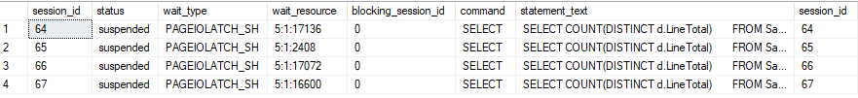
Disk I/O monitoring and troubleshooting
Notice suspended sessions, review the wait_type and wait_resource
Decompose the wait resource with the new DMVs, sessions are waiting for Data Pages
Pending IO requests will also appear

Slide 40
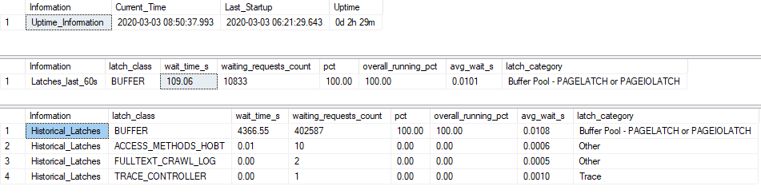
Disk I/O monitoring and troubleshooting
Review latch stats
BUFFER
Used to synchronize short term access to database pages. A buffer latch is required before reading or modifying any database page. Buffer latch contention can indicate several issues, including hot pages and slow I/Os.
This latch class covers all possible uses of page latches. sys.dm_os_wait_stats makes a difference between page latch waits that are caused by I/O operations and read and write operations on the page.
Notes:
sys.dm_os_latch_stats (Transact-SQL)
From <https://docs.microsoft.com/en-us/sql/relational-databases/system-dynamic-management-views/sys-dm-os-latch-stats-transact-sql?view=sql-server-ver15>

Slide 41
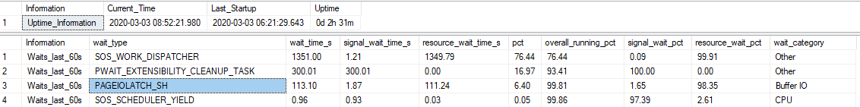
Disk I/O monitoring and troubleshooting
Review wait stats
PAGEIOLATCH_SH
Occurs when a task is waiting on a latch for a buffer that is in an I/O request. The latch request is in Shared mode. Long waits may indicate problems with the disk subsystem.
Notes:
sys.dm_os_wait_stats (Transact-SQL)
From <https://docs.microsoft.com/en-us/sql/relational-databases/system-dynamic-management-views/sys-dm-os-wait-stats-transact-sql?view=sql-server-ver15>

Slide 42
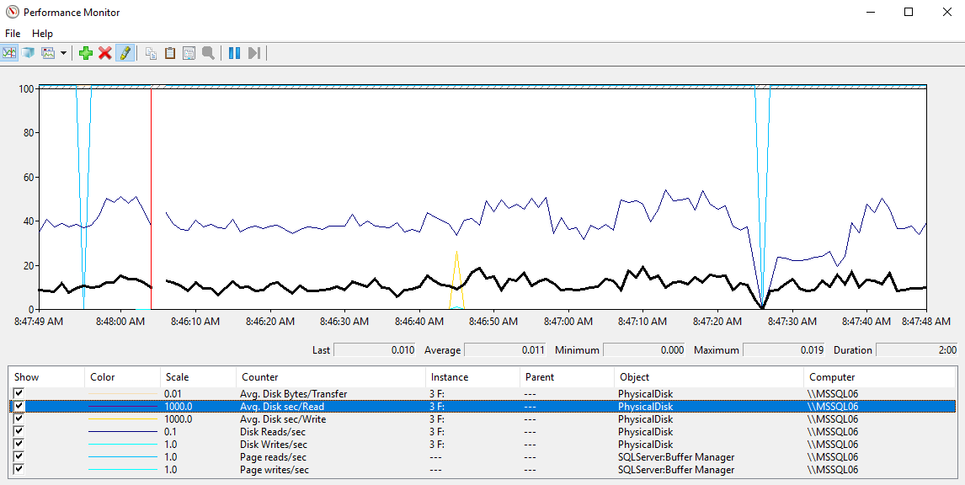
Disk I/O monitoring and troubleshooting
Review the performance counters for the Physical disk and determine if the latency is good.
Review the # of operations per second, are those high? Compare Disk Read/sec vs Page Read/Sec

Slide 43
DMV’s and perf counters in this lesson
sys.dm_exec_requests
sys.fn_PageResCracker
sys.dm_db_page_info
sys._dm_os_latch_stats
sys.dm_os_wait_stats
sys.dm_io_virtual_file_stats
sys.dm_io_pending_io_requests
Perf Counters:
\PhysicalDisk\Avg. Disk Bytes/Transfer
\PhysicalDisk\Avg. Disk sec/Read
\PhysicalDisk\Avg. Disk sec/Write
\PhysicalDisk\Disk Reads/sec
\PhysicalDisk\Disk Writes/sec
\SQLServer:Buffer Manager\Page reads/sec
\SQLServer:Buffer Manager\Page writes/sec

Slide 44

Disk I/O
Monitoring and Troubleshooting Disk I/O
Notes:
The files for this Lab are located at E:\Labfiles\M03L03Lab01

Slide 45
Questions?

Slide 46
Knowledge Check
What is the recommended tool to measure disk latency?
What DMV/DMF is used to identify pending IO requests?
What are the notable wait types for disk I/O?
Notes:
Q1) What tool should is used to measure disk latency?
A1) Perfmon to monitor the following perf counters
Avg. Disk Bytes/Transfer
Avg. Disk sec/Read
Avg. Disk sec/Write
Q2) What DMV/DMF is used to identify pending IO requests?
A2) SQL Server DMV sys.dm_io_pending_io_requests
What are the notable wait types for disk I/O?
ASYNC_IO_COMPLETION
IO_COMPLETION
LOGMGR
WRITELOG
PAGEIOLATCH

Slide 47
Lesson 4: SQL Server Data File Structure

Slide 48
Objectives
After completing this learning, you will be able to:
Understand the data file structure.
Describe SQL Server allocation objects, and object allocation process.

Slide 49
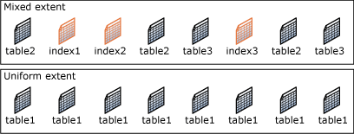
SQL Server object allocation
Data files are structured in extents.
Each extent (64 KB) has eight pages of 8 KB each.
Two types of extents:
Mixed extents
Up to 8 distinct objects can reside in the same Mixed Extent.
Controlled by SGAM (Shared Global Allocation Map) Object.
Uniform extents
All pages belong to the same object.
Controlled by GAM (Global Allocation Map) object.
Notes:
Extents
Extents are the basic unit in which space is managed. An extent is eight physically contiguous pages, or 64 KB. This means SQL Server databases have 16 extents per megabyte.
SQL Server has two types of extents:
Uniform extents are owned by a single object; all eight pages in the extent can only be used by the owning object.
Mixed extents are shared by up to eight objects. Each of the eight pages in the extent can be owned by a different object.
Additional Reading:
Pages and Extents Architecture Guide
From <https://docs.microsoft.com/en-us/sql/relational-databases/pages-and-extents-architecture-guide?view=sql-server-ver15>

Slide 50
The Role of Allocation Pages in Object Allocation
PFS and IAM are used to determine when an object needs a new extent allocated
GAMs and SGAMs are used to allocate the extent
Notes:
PFS and IAM are used to determine when an object needs a new extent allocated
When SQL Server needs to insert a new row, but there is no space available in the current page, SQL Server uses the IAM and PFS pages to find a page with enough space to hold the row. First, SQL Server uses the IAM pages to find the extents allocated to the object. Then, for each extent, SQL Server searches the PFS pages to see if there is a page with enough free space to hold the row. Each IAM and PFS page covers a large number of data pages, which are generally stored in the memory in the SQL Server buffer pool. This means that these pages can be searched quickly.
SQL allocates a new extent to an object only when it cannot quickly find a page in an existing extent with enough space to hold the row that is being inserted. It allocates extents from those available in the filegroup by using a proportional fill algorithm (files are used in proportion to their free space). Every file in a filegroup should have a similar percentage of space used.
Heaps have one row in sys.partitions with index_id = 0. The first_iam_page column in sys.system_internals_allocation_units points to the IAM chain for the collection of heap data pages in the specified partition. The server uses the IAM pages to find the pages in the data page collection.
SQL Server uses the IAM pages to navigate through the heap. Data pages and the rows within them are not in any specific order and are not linked together. The only logical connection between data pages in a heap is the connection recorded in the IAM pages.
The IAM pages can be scanned to perform table scans or serial reads of a heap to find the extents holding pages for the heap. Because the IAM represents extents in the same order that they exist in the data files, serial heap scans progress uniformly down each file. Using the IAM pages to set the scan sequence also means that rows from the heap are not typically returned in the order in which they were inserted.

Slide 51

Allocation objects
Page Free Space (PFS)
Tracks free space on a page uses 1 Byte/Page
Covers 64 MB worth of pages
Global Allocation Map (GAM)
Tracks Uniform extents that have been allocated uses 1 Bit/extent
Covers 64,000 extents (4 GB worth of data)
Shared Global Allocation Map (SGAM)
Tracks Mixed extents that have all 8 pages allocated uses 1 Bit/extent
Covers 64,000 extents (4 GB worth of data)
Index Allocation Map (IAM)
Tracks extents that are allocated to an allocation unit
Covers 4 GB worth of data
One IAM chain per table, per index, per partition, per allocation unit type
Notes:
PFS and IAM are used to determine when an object needs a new extent allocated
When SQL Server needs to insert a new row, but there is no space available in the current page, SQL Server uses the IAM and PFS pages to find a page with enough space to hold the row. First, SQL Server uses the IAM pages to find the extents allocated to the object. Then, for each extent, SQL Server searches the PFS pages to see if there is a page with enough free space to hold the row. Each IAM and PFS page covers a large number of data pages, which are generally stored in the memory in the SQL Server buffer pool. This means that these pages can be searched quickly.
SQL allocates a new extent to an object only when it cannot quickly find a page in an existing extent with enough space to hold the row that is being inserted. It allocates extents from those available in the filegroup by using a proportional fill algorithm (files are used in proportion to their free space). Every file in a filegroup should have a similar percentage of space used.
Heaps have one row in sys.partitions with index_id = 0. The first_iam_page column in sys.system_internals_allocation_units points to the IAM chain for the collection of heap data pages in the specified partition. The server uses the IAM pages to find the pages in the data page collection.
SQL Server uses the IAM pages to navigate through the heap. Data pages and the rows within them are not in any specific order and are not linked together. The only logical connection between data pages in a heap is the connection recorded in the IAM pages.
The IAM pages can be scanned to perform table scans or serial reads of a heap to find the extents holding pages for the heap. Because the IAM represents extents in the same order that they exist in the data files, serial heap scans progress uniformly down each file. Using the IAM pages to set the scan sequence also means that rows from the heap are not typically returned in the order in which they were inserted.

Slide 52

Database File page layout
Page Address is
DBID:FileID:Page#
5:1:1
MyDBFile2.ndf
MyDBFile1.mdf
0 | Header
1 | PFS
2 | GAM
3 | SGAM
… | IAM/Data /Index/others
8088 | PFS
… | IAM/Data /Index/others
511232 | GAM
511233 | SGAM
Header
0
1
2
3
…
8088
…
511232
511233
PFS
GAM
SGAM
Page Free Space
8,087 Pages
IAM/Data /Index/etc.
Global Allocation Map
Uniform Extents
63,904 Extents
PFS
Shared Global Allocation Map
Mixed Extents
63,904 Extents
IAM/Data /Index/others
GAM
SGAM
Notes:
SQL Server databases have at least one data file called the Primary data file, which will typically have a .mdf extension. They can also have secondary data files with .ndf extensions. This is the default naming convention, but any file extensions the user specifies will be accepted.
When a database has multiple files, the files are numbered from 1 to n, n being the total number of files. Each file consists of a collection of pages numbered from 0 to n-1, n being the number of pages in the file (total number of pages will depend on the size of the file).
The special Object Allocation pages mentioned on the previous slide will always appear in the same location in each data file contained in a database. A PFS page is the first page after the file header page in a data file and is marked as page 1. Following the PFS page is a GAM, marked as page 2, followed by an SGAM, marked as page 3. After the first PFS, there will be a new PFS page after every 8,087 pages. There is a new GAM for each 63,904 extents after the first GAM on page 2, and a new SGAM each 63,904 extents after the first SGAM on page 3.
The SQL Server engine addresses each of these pages using a combination of database id, file id, and page number. For example, the SGAM page in the first data file of a user database with a database id of 5 will be notated as 5:1:3. This becomes important when troubleshooting any type of page-related wait as the wait resource will be listed using this notation.
Additional Reading:
Database Files and Filegroups
From <https://docs.microsoft.com/en-us/sql/relational-databases/databases/database-files-and-filegroups?view=sql-server-ver15>

Slide 53
SQL Server object allocation
Starting with SQL Server 2016 (13.x)
Decreases contention on SGAM objects
Default for allocations in the database is Uniform extents for Data pages
Up to, and including, SQL Server 2014 (12.x)
On object creation 2 pages from a mixed extents are allocated
After 8 data pages, new allocation comes from Uniform Extent
Notes:
Up to, and including, SQL Server 2014 (12.x)
On object creation 2 pages from a mixed extents are allocated:
1st page is for the object itself
2nd page contains the list of all pages used by the object (IAM)
As more space is needed, additional pages are added:
Up to 8 data pages, new pages are added individually from mixed extents
After 8 data pages, new allocation comes from Uniform Extent – i.e. 8 pages are allocated
The corresponding IAM gets updated to reflect new page(s)
Additional Reading:
Pages and Extents Architecture Guide
From <https://docs.microsoft.com/en-us/sql/relational-databases/pages-and-extents-architecture-guide?view=sql-server-ver15>

Slide 54
SQL Server object allocation (Trace Flag 1118)
Up to, and including, SQL Server 2014 (12.x)
Trace flag 1118 is used to change default allocation to use uniform extents
Starting with SQL Server 2016 (13.x)
For TempDB: TF 1118 functionality is automatically enabled.
For user databases: behavior controlled with SET MIXED_PAGE_ALLOCATION option of ALTER DATABASE
default value set to OFF
TF 1118 has no effect.
Notes:
Additional Reading:
Pages and Extents Architecture Guide
From <https://docs.microsoft.com/en-us/sql/relational-databases/pages-and-extents-architecture-guide?view=sql-server-ver15>

Slide 55
Tying it all together
Calculate the Record Size
Check if Table has pages (IAM Page)
YES
Do these pages have unallocated space (PFS Page)
YES
Insert record Update the PFS Page
NO
Allocate New Page
NO
Allocate a page from Mixed Extent (SGAM)
Update the allocation objects
NO
Is TF 1118 Enabled?
More than 8 Pages?
SQL Server>=13.X ?
YES
Allocate a Uniform Extent (GAM)
Update the allocation objects.
Notes:
Consider a scenario, where the user is trying to insert/update a record into the database table. Represented below is a very high level overview of the algorithm/process SQL Server uses to insert/update the record. There is another thing which SQL Server has to check when doing an INSERT operation. But those are not important for this discussion about the Allocation objects.
Calculate the space required for the inserted record (or could be updated record size).
Check if the Table already had some pages allocated (use IAM page/Clustered Index Root Page). In case of update, this would always be true.
Check if any of these pages has enough unallocated space to fit the new record (PFS Page/Page header). If there is enough space, insert record and update PFS page/Page header with the information related to unallocated space and other related information.
If there is not enough unallocated space on the pages, allocate a New Page.
Check if TF 1118 (uniform Extent allocation) is enabled or if the table has more than eight pages already allocated or if SQL Server is 13.x or later.
If yes, allocate a new Uniform extent to the table, else allocate a page from one of the Mixed extents (GAM/SGAM Pages). Update GAM/SGAM, to reflect the changes (mark the extent used in case it was uniform extent allocation, or if the mixed extent is full). Additionally, update the IAM Page with the information.
Insert the record on the newly allocated page, update the PFS Page, with the unallocated space information.

Slide 56
Differential Changed Map (DCM)
Differential backups read the DCM pages to determine which extents have been modified and needs to be backed up.
Tracks the extents that have changed since the last BACKUP DATABASE statement.
0
1
.
.
.
.
DCM Bitmap = 1 Bit
Bit = 0: Extent has not been modified
Bit = 1: Extent has been modified
Notes:
Differential Changed Map (DCM) This tracks the extents that have changed since the last BACKUP DATABASE statement. If the bit for an extent is 1, the extent has been modified since the last BACKUP DATABASE statement. If the bit is 0, the extent has not been modified. Differential backups read just the DCM pages to determine which extents have been modified. This greatly reduces the number of pages that a differential backup must scan. The length of time that a differential backup runs is proportional to the number of extents modified since the last BACKUP DATABASE statement and not the overall size of the database.
Additional Reading:
Pages and Extents Architecture Guide
From <https://docs.microsoft.com/en-us/sql/relational-databases/pages-and-extents-architecture-guide?view=sql-server-ver15>

Slide 57
Bulk Changed Map (BCM)
This tracks the extents that have been modified by bulk logged operations (bcp, BULK INSERT, INSERT... SELECT, SELECT INTO, ALTER INDEX REBUILD, and others) since the last BACKUP LOG statement.
0
1
.
.
.
.
BCM Bitmap = 1 Bit
Bit = 0: Extent has not been modified by bulk logged operations.
Bit = 1: Extent has been modified by a bulk logged operation after the last BACKUP LOG statement
Although BCM pages appear in all databases, they are only relevant when the database is using the bulk-logged recovery model.
Notes:
Bulk Changed Map (BCM) This tracks the extents that have been modified by bulk logged operations since the last BACKUP LOG statement. If the bit for an extent is 1, the extent has been modified by a bulk logged operation after the last BACKUP LOG statement. If the bit is 0, the extent has not been modified by bulk logged operations. Although BCM pages appear in all databases, they are only relevant when the database is using the bulk-logged recovery model. In this recovery model, when a BACKUP LOG is performed, the backup process scans the BCMs for extents that have been modified. It then includes those extents in the log backup. This lets the bulk logged operations be recovered if the database is restored from a database backup and a sequence of transaction log backups. BCM pages are not relevant in a database that is using the simple recovery model, because no bulk logged operations are logged. They are not relevant in a database that is using the full recovery model, because that recovery model treats bulk logged operations as fully logged operations.
Additional Reading:
Pages and Extents Architecture Guide
From <https://docs.microsoft.com/en-us/sql/relational-databases/pages-and-extents-architecture-guide?view=sql-server-ver15>

Slide 58
Questions?

Slide 59
Knowledge Check
What is the I/O pattern for accessing data files?
What operations causes write to the data files?
What is an extent?
What was the object allocation behavior that changed in SQL Server 2016?
What special pages are used to control object allocation?
Notes:
Q1) What is the file pattern usage for data files?
A1) Random read and writes
Q2) What operations causes write operations to the data files?
A2) Write activity during checkpoints, recovery, and lazy writes
Q3) What is an extent?
A3) A group of 8 pages of 8 KB each for a total of 64 KB
Q4) What is the object allocation behavior change starting SQL Server 2016?
A4) Starting with SQL Server 2016 (13.x), the default for all allocations in the database is uniform extents
Q5) What special pages are used to control object allocation?
A5) PFS, GAM, SGAM, IAM

Slide 60
Lesson 5: SQL Server TempDB File Structure

Slide 61
Objectives
After completing this learning, you will be able to:
Understand the TempDB database structure.
Optimize TempDB database.
Use the newest improvements in SQL Server for TempDB database.

Slide 62
TempDB database
System database
Available to all users with the same structure as user databases.
Operations are minimally logged.
Re-created every time SQL Server is started.
Workload
Used for temporary (non-durable) storage.
Object and data frequently being created and destroyed.
Very high concurrency.
Backup and restore operations are not allowed on TempDB.
Notes:
Operations within TempDB are minimally logged so that transactions can be rolled back. TempDB is re-created every time SQL Server is started so that the system always starts with a clean copy of the database. Temporary tables and stored procedures are dropped automatically on disconnect, and no connections are active when the system is shut down. Therefore, there is never anything in TempDB to be saved from one session of SQL Server to another. Backup and restore operations are not allowed on TempDB.
TempDB Database
From <https://docs.microsoft.com/en-us/sql/relational-databases/databases/tempdb-database?view=sql-server-ver15#memory-optimized-tempdb-metadata>

Slide 63
What is stored in TempDB?
Temporary user objects
Global or local temporary tables and indexes
Temporary stored procedures
Table variables
Tables returned in table-valued functions, or cursors
Internal objects
Worktables to store intermediate results for spools, cursors, sorts, and temporary LOB storage.
Work files for hash join or hash aggregate operations.
Intermediate sort results for operations such as creating or rebuilding indexes (if SORT_IN_TEMPDB is specified), or certain GROUP BY, ORDER BY, or UNION queries.
Version stores
Common version store
Online-index-build version store
Notes:
Temporary user objects that are explicitly created, such as:
Global or local temporary tables and indexes
Temporary stored procedures
Table variables
Tables returned in table-valued functions, or cursors
Internal objects that are created by the database engine. These include:
Work tables to store intermediate results for spools, cursors, sorts, and temporary large object (LOB) storage.
Work files for hash join or hash aggregate operations.
Intermediate sort results for operations such as creating or rebuilding indexes (if SORT_IN_TEMPDB is specified), or certain GROUP BY, ORDER BY, or UNION queries.
Version stores, which are a collection of data pages that hold the data rows that are required to support the features that use row versioning. There are two version stores: a common version store and an online-index-build version store. The version stores contain:
Row versions that are generated by data modification transactions in a database that uses read-committed using row versioning isolation or snapshot isolation transactions.
Row versions that are generated by data modification transactions for features, such as: online index operations, Multiple Active Result Sets (MARS), and AFTER triggers.
It Just Runs Faster: SQL Server 2019 TempDB Improvements
From <https://learn.microsoft.com/en-us/shows/data-exposed/it-just-runs-faster-sql-server-2019-tempdb-improvements>

Slide 64
Physical properties of TempDB
File | Logical name | Physical name | Initial size | File growth
Primary data | tempdev | tempdb.mdf | 8 MB | Autogrow by 64 MB until the disk is full
Secondary data files* | temp# | tempdb_mssql_#.ndf | 8 MB | Autogrow by 64 MB until the disk is full
Log | templog | templog.ldf | 8 MB | Autogrow by 64 megabytes to a maximum of 2 terabytes
If the number of logical processors is less than or equal to eight (8), use the same number of data files as logical processors.
If the number of logical processors is greater than eight (8), use eight data files.
Alternatively, make changes to the workload or code.
If contention continues, increase the number of data files by multiples of four (4) up to the number of logical processors
Notes:
* As a general rule:
If the number of logical processors is less than or equal to eight (8), use the same number of data files as logical processors.
If the number of logical processors is greater than eight (8), use eight data files. If contention continues, increase the number of data files by multiples of four (4) up to the number of logical processors until the contention is reduced to acceptable levels.
Alternatively, make changes to the workload or code.
Physical Properties of TempDB in SQL Server
From <https://docs.microsoft.com/en-us/sql/relational-databases/databases/tempdb-database?view=sql-server-ver15#physical-properties-of-tempdb-in-sql-server>

Slide 65
Optimizing TempDB performance
Consider instant file initialization
Pre-allocate space for all TempDB files
Divide TempDB into multiple data files of equal size
Put the TempDB database on a fast I/O subsystem
Use disk striping if there are many directly attached disks.
Put the TempDB database on separate disks from user databases
Notes:
If possible, use database instant file initialization to improve the performance of data file grow operations.
Preallocate space for all TempDB files by setting the file size to a value large enough to accommodate the typical workload in the environment.
The TempDB database should be set to autogrow, but this should be used to increase disk space for unplanned exceptions.
Data files should be of equal size within each filegroup, as SQL Server uses a proportional-fill algorithm that favors allocations in files with more free space.
Dividing TempDB into multiple data files of equal size provides a high degree of parallel efficiency in operations that use TempDB.
Put the TempDB database on a fast I/O subsystem. Use disk striping if there are many directly attached disks. Individual or groups of TempDB data files do not necessarily need to be on different disks or spindles unless you are also encountering I/O bottlenecks.
Put the TempDB database on disks that differ from those that are used by user databases.
Performance improvements in TempDB for SQL Server
From <https://docs.microsoft.com/en-us/sql/relational-databases/databases/tempdb-database?view=sql-server-ver15#performance-improvements-in-tempdb-for-sql-server>

Slide 66
Performance improvements in TempDB
Starting with SQL Server 2016 (13.x)
Trace Flags 1117 and 1118 behavior enabled by default for TempDB
Temporary tables and table variables are cached.
Allocation page latching protocol improved.
Logging overhead for TempDB is reduced.
Notes:
Temporary tables and table variables are cached. Caching allows operations that drop and create the temporary objects to execute very quickly and reduces page allocation contention.
Allocation page latching protocol is improved to reduce the number of UP (update) latches that are used.
Logging overhead for TempDB is reduced to reduce disk I/O bandwidth consumption on the TempDB log file.
Setup adds multiple TempDB data files during a new instance installation. This task can be accomplished with the new UI input control on the Database Engine Configuration section and a command-line parameter /SQLTEMPDBFILECOUNT. By default, setup adds as many TempDB data files as the logical processor count or eight, whichever is lower.
When there are multiple TempDB data files, all files autogrow at same time and by the same amount depending on growth settings. Trace flag 1117 is no longer required.
All allocations in TempDB use uniform extents. Trace flag 1118 is no longer required.
For the primary filegroup, the AUTOGROW_ALL_FILES property is turned on and the property cannot be modified.

Slide 67
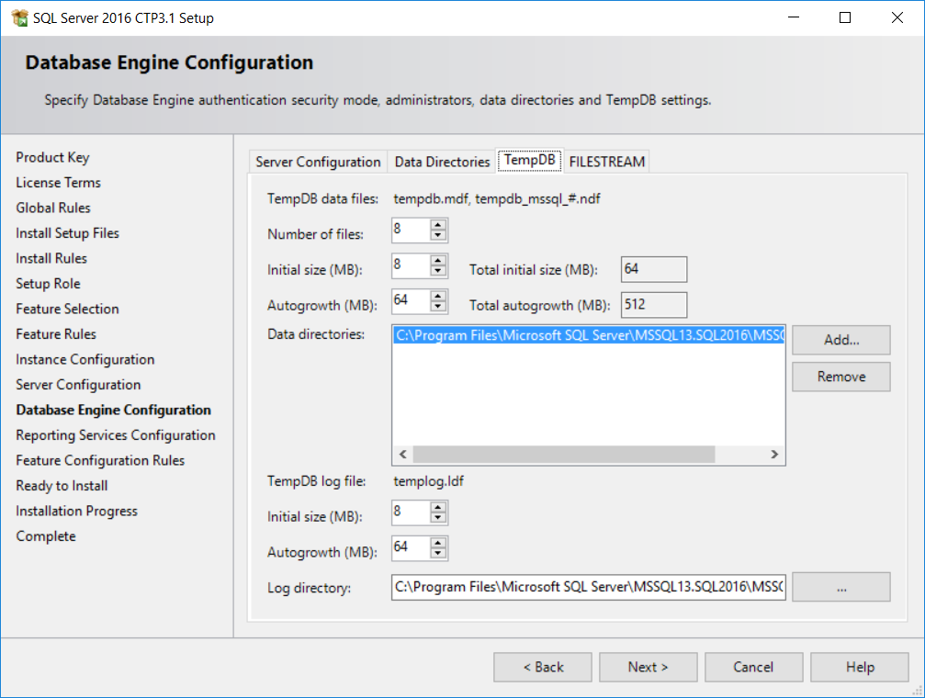
Performance improvements in TempDB
Starting with SQL Server 2016 (13.x)
Setup adds multiple TempDB data files during instance installation.
By default, setup adds as many TempDB data files as the logical processor count or eight, whichever is lower.
Notes:
SQL 2016 - It Just Runs Faster: Automatic TEMPDB Configuration
From <https://docs.microsoft.com/en-us/archive/blogs/bobsql/sql-2016-it-just-runs-faster-automatic-tempdb-configuration>

Slide 68
Performance improvements in TempDB
Starting with SQL Server 2019 (15.x)
Default
Temp table cache improvements
Concurrent PFS updates
Opt-in
Memory-Optimized TempDB Metadata
TEMPDB Files, Trace Flags, and Updates by Pam Lahoud
How (and When) To: Memory Optimized TempDB
Notes:
Share this link: https://techcommunity.microsoft.com/t5/sql-server/tempdb-files-and-trace-flags-and-updates-oh-my/ba-p/385937
Share this video: https://www.youtube.com/watch?v=g4aemv5O9as&t=1s
Memory-Optimized TempDB Metadata
System tables involved in managing temporary table metadata can be moved into latch-free non-durable memory-optimized tables.
Considerations
This configuration change requires a restart of the service to take effect.
A single transaction may not access memory-optimized tables in more than one database. This means that any transactions that involve a memory-optimized table in a user database will not be able to access TempDB system views in the same transaction.
Queries against memory-optimized tables do not support locking and isolation hints, so queries against memory-optimized TempDB catalog views will not honor locking and isolation hints.
Columnstore indexes cannot be created on temporary tables when Memory-Optimized TempDB Metadata is enabled.
Due to the limitation on columnstore indexes, use of the sp_estimate_data_compression_savings system stored procedure with the COLUMNSTORE or COLUMNSTORE_ARCHIVE data compression parameter is not supported when Memory-Optimized TempDB Metadata is enabled.

Slide 69
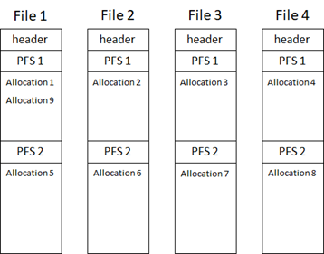
Concurrent PFS, GAM, SGAM updates
Starting with SQL Server 2019 (15.x), improved in SQL Server 2022 (16.x)
With this change, not only will increasing the number of files help with PFS contention also increasing the size of the files.
SQL Server 2019 introduced Concurrent PFS Updates.
New algorithm to round robin between files, and between PFS pages within the files.
SQL Server 2022 introduced Concurrent GAM and SGAM Updates.
Notes:
There are some cases where having multiple files alone does not completely address PFS contention. For these cases, we have implemented a fix where we not only round robin between the files, we also round robin between the PFS pages within the files, allowing us to spread the object allocations across all the files and within the files themselves.
Over the past several SQL Server releases, Microsoft has improved the concurrency and performance of the tempdb database. In SQL Server 2022 we are addressing one of the last areas of contention by introducing concurrent global allocation map (GAM) and shared global allocation map (SGAM) updates which will give SQL Server 2022 a big improvement for scalability as tempdb is arguably the most important database in your environment.
https://cloudblogs.microsoft.com/sqlserver/2022/07/21/improve-scalability-with-system-page-latch-concurrency-enhancements-in-sql-server-2022/

Slide 70
TempDB
Monitoring and troubleshooting TempDB
Exercise 1 – Troubleshoot object allocation contention in TempDB
Exercise 2 – Implement Memory Optimized TempDB Metadata to reduce object allocation contention
Notes:
The files for this Lab are located at E:\Labfiles\M03L05Lab01

Slide 71
Questions?

Slide 72
Knowledge Check
What is stored in TempDB?
How can you boost TempDB performance?
Notes:
Q1) What is stored in TempDB?
A1) Temporary user objects, like:
Global or local temporary tables and indexes
Temporary stored procedures
Table variables
Tables returned in table-valued functions, or cursors
Internal objects
Worktables to store intermediate results for spools, cursors, sorts, and temporary LOB storage.
Work files for hash join or hash aggregate operations.
Intermediate sort results for operations such as creating or rebuilding indexes (if SORT_IN_TEMPDB is specified), or certain GROUP BY, ORDER BY, or UNION queries.
Version stores
Common version store.
Online-index-build version store.
Q2) How can you boost performance in TempDB?
A2) Consider:
Instant file initialization
Pre-allocate space for all TempDB files
Divide TempDB into multiple data files of equal size
Put the TempDB database on a fast I/O subsystem
Use disk striping if there are many directly attached disks
Put the TempDB database on separate disks from user databases

Slide 73
Lesson 6: SQL Server Log File Structure

Slide 74
Objectives
After completing this learning, you will be able to:
Understand the log file structure.
Explain SQL Server logging process.

Slide 75
SQL Server disk I/O patterns: transaction log
One .ldf file per database
Sequential reads and writes
Write activity during the log buffer flush operations
Read activity during checkpoints, backups, and recovery
Features such as database mirroring and replication will increase read and write activity
Notes:
Having more than one log file per database is possible, but it is not recommended. Log files are written to a single file sequentially, so multiple log files will not provide any performance benefit.

Slide 76
Transaction Log
Sequence of log records contained in one or more physical files
Records identified by increasing Logical Sequence Numbers (LSNs)
Recorded operations:
Start and end of each transaction
All database modifications
Extent and page allocation or deallocation
Creating and dropping objects
Notes:
The transaction log in a database maps over one or more physical files, which are separate from the data files containing data pages. Logically, the log file is a string of log records that track modifications made to the database. Each log record is identified by a log sequence number (LSN). Each new log record is written to the logical end of the log with an LSN that is higher than the LSN of the record before it. Each log record contains the ID of the transaction that it belongs to. For each transaction, all log records associated with the transaction are linked in a chain using backward pointers for fast recovery. Many types of operations are recorded in the transaction log including:
Start and end of each transaction
All data modifications
Extent and page allocation or deallocation
Creating and dropping objects
Log records for data modification record either the logical operation performed, or they record the before and after images of the modified data. The before image is a copy of the data before the operation is performed and the after image is a copy of the data after the operation has been performed.
Each transaction reserves space on the transaction log to make sure enough log space is available to support a rollback of the transaction. Generally, this space is equal to the amount of space required to log each operation and is freed when the transaction is completed.
SQL Server Transaction Log Architecture and Management Guide
From <https://docs.microsoft.com/en-us/sql/relational-databases/sql-server-transaction-log-architecture-and-management-guide?view=sql-server-ver15>

Slide 77
Microsoft SQL Server Transaction Logging
Record the Begin Transaction in the Log Buffer
Log the DML operation in the Log Buffer (INS/UPD/DEL)
Read the Data/Index Pages and perform the operation in memory.
If Log Flush Succeeds
Commit the Transaction
Flush to LDF
Report the transaction success to the user
If Log Flush Fails
Rollback the transaction
Notes:
Consider a scenario where an Insert/Update/Delete operation is being performed on a SQL Server table. How does SQL Server log this information in the transaction logs and later use it for recovery purposes. In this slide, we would talk about the high level overview of the operations (logging related) which happen when a record is Inserted/Deleted/Updated in a table.
Mark the beginning of the transaction in the Log Buffer (60 KB).
Log details about the nature of the transaction in the Log Buffer.
Read the page from the disk, where the operation needs to be performed (Page Latch/Locking).
Perform the modification (Page marked Dirty**/Latching/Locking).
Commit the transaction. During the commit flush, the log buffer to the LDF file (Log buffer could also be flushed if it is full, without having to wait from the commit) as a Synchronous process. After the write to the LDF file has been performed, send acknowledgement to the client/user.
SQL Server Transaction Log Architecture and Management Guide
From <https://docs.microsoft.com/en-us/sql/relational-databases/sql-server-transaction-log-architecture-and-management-guide?view=sql-server-ver15>

Slide 78
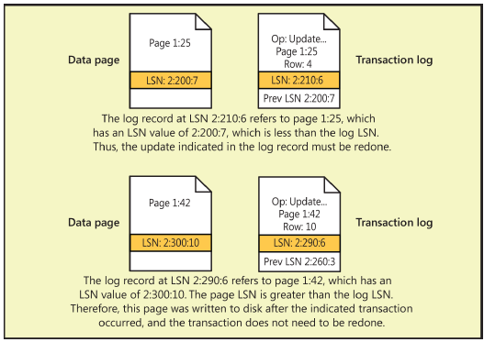
Page LSN and recovery
Last LSN in the page header
Log Record has two LSNs
Previous LSN from the data page
Current log record LSN
All used for recovery
Notes:
Every database page has an LSN in the page header that reflects the location in the transaction log of the last log entry that modified a row on that page. Each log record that represents changes to a data page has two LSNs associated with it. In addition to the LSN for the actual log record, it keeps track of the LSN that was on the data page before the change recorded by this log record. During a redo operation of transactions, the LSN for each log record is compared to the page LSN of the data page that the log entry modified. If the page LSN is equal to the previous page LSN in the log record, the operation indicated in the log entry is redone. If the LSN on the page is equal to or higher than the actual LSN for this log record, SQL Server database skips the REDO operation.
As recovery finds the last checkpoint record in the log (also, transactions that were still active at the time of the checkpoint) and proceeds from there, recovery time is short, and all changes committed before the checkpoint can be purged from the log or archived. Otherwise, recovery can take a long time and transaction logs can become unreasonably large. A transaction log cannot be truncated before the point of the earliest transaction that is still open, no matter how many checkpoints have occurred since the transaction started and how many other transactions have started or completed. If a transaction remains open, the log must be preserved because it is still not clear whether the transaction is done or ever will be done. The transaction might ultimately need to be rolled back or rolled forward.

Slide 79
Physical Log File Structure
The physical file is divided into virtual log files (VLFs).
SQL Server works to keep the number of VLFs small.
VLF size and number is dynamic and cannot be configured or set.
Log file is circular. When the end of logical log meets the beginning, the physical log file is extended.
Virtual Log 1
Virtual Log 2
Virtual Log 3
Virtual Log 4
Truncated
MinLSN
Last checkpoint
End of logical log
Start of logical log
Next to last checkpoint
Notes:
SQL Server divides each physical log file internally into a number of virtual log files (VLFs) containing log records. VLFs have no fixed size, and there is no fixed number of virtual log files for a physical log file. The size of the virtual log files is determined dynamically by SQL Server when creating or extending the physical log files. SQL Server tries to maintain a small number of VLFs for the best performance. The size or number of virtual log files cannot be configured or set by system administrators, but it can be influenced by the initial creation of the transaction log file and the subsequent growth of that file.
When creating or growing a transaction log file, the size and number of the VLFs is determined by the size of the piece being added to the file as follows:
Less than 64 MB = 4 VLFs
Greater than 64 MB and less than 1 GB = 8 VLFs
Greater than or equal to 1 GB = 16 VLFs
For example, if you initially create a 1 GB transaction log file, it will be divided into 16 64 MB VLFs. With the default auto-growth setting of 10%, the first auto-grow would add 102.4 MB of space in the form of eight 12.8 MB VLFs and so on.
http://www.sqlskills.com/BLOGS/KIMBERLY/post/Transaction-Log-VLFs-too-many-or-too-few.aspx

Slide 80
Addressing VLF Counts
VLF count T-LOG file creation
Size <= 64 MB → 4 VLFs
VLF count at T-LOG file growth
Growth <= 64 MB → 4 VLFs
Between 64 MB and 1 GB → 8 VLFs
Size > 1GB →16 VLFs
Between 64 MB and 1GB → 8 VLFs
Growth > 1GB → 16 VLFs
If growth is less than 1/8th of current size → add 1 VLF
(SQL 2014 and higher)
Notes:
Additionally, avoid having too big\ too few VLFs.
Checking the SQL Server Error Log - xp_readerrorlog 0,1,N'VLF'
Reference:
Transaction Log Physical Architecture
From <https://docs.microsoft.com/en-us/sql/relational-databases/sql-server-transaction-log-architecture-and-management-guide?view=sql-server-ver15#physical_arch>

Slide 81
SQL Server 2014 VLF Growth Improvement
Is the growth size less than 1/8 the size of the current log size?
Yes: create 1 new VLF equal to the growth size
No: use the previous formula
Example of a 256 MB log file with an autogrowth setting of 5 MB
2012 and earlier: 10 auto-grows of 5MB would add 4 VLFs x 10 auto-grows
2014 and later: 10 auto-grows of 5MB each would only create 10 VLFs
Grow Iterations + Log size | Up to SQL Server 2012 | From SQL Server 2014
0 (256 MB) | 8 | 8
10 (306 MB) | 48 | 18
20 (356 MB) | 88 | 28
80 (656 MB) | 328 | 88
250 (1.2 GB) | 1008 | 258
3020 (15 GB) | 12091 | 3028
Notes:
For SQL Server 2014, the algorithm is now:
Is the growth size less than 1/8 the size of the current log size?
Yes: create 1 new VLF equal to the growth size
No: use the previous formula
Reference:
http://www.sqlskills.com/blogs/paul/important-change-vlf-creation-algorithm-sql-server-2014/
Key Points:
Fixing involves getting your t-log to a minimum size (and thus VLF number) and growing in pre-determined growth iterations until you reach the desired state, with VLFs no larger than 512 MB.
As a less conventional solution, but one that works, create a database snapshot and then revert to it. This deletes the t-log and creates a small log with two small VLFs. This is a bug that has been active since the Microsoft SQL Server 2005 product, but be aware it breaks your log backup chain.
Additional Reading:
For more information, see: Can log files growth affect DML? Post-CU Update –
https://techcommunity.microsoft.com/t5/sql-server-blog/can-log-files-growth-affect-dml/ba-p/383678
https://techcommunity.microsoft.com/t5/sql-server-blog/can-log-files-growth-affect-dml-post-cu-update/ba-p/383860
For more information, see: Fixing VLFs - https://techcommunity.microsoft.com/t5/sql-server-blog/sql-swiss-army-knife-9-fixing-vlfs/ba-p/383879

Slide 82
Addressing VLF Counts
To avoid VLF fragmentation
Pre-size log files to avoid unplanned file growth
Set autogrowth to an appropriate fixed size
To view VLFs
DBCC LOGINFO (<database_id>)
sys.dm_db_log_info (SQL Server 2016 SP2 and higher )
Active VLFs have a status of 2
SQL Server Error Log (SQL 2012 and higher)
Notes:
Additionally, avoid having too big\ too few VLFs.
Checking the SQL Server Error Log - xp_readerrorlog 0,1,N'VLF'
Reference:
Transaction Log Physical Architecture
From <https://docs.microsoft.com/en-us/sql/relational-databases/sql-server-transaction-log-architecture-and-management-guide?view=sql-server-ver15#physical_arch>

Slide 83
Demonstration
Examining log use
Notes:
Demo files used in the older version of the Workshop releases are retained in E:\Archived (this is for any reference)
You can open all the demonstrations by using the solutions file :
E:\Demos\SQL_PTO_Workshop_Demos.ssmssln
Individual SQL demo file.
E:\Demos\03_Database_Structure\TransactionalLog.sql

Slide 84
Questions?

Slide 85
Knowledge Check
What is a VLF?
What can be done to avoid having too many VLFs in the transaction log?
Notes:
What is a VLF?
The SQL Server Database Engine divides each physical log file internally into a number of virtual log files (VLFs). Virtual log files have no fixed size, and there is no fixed number of virtual log files for a physical log file. The Database Engine chooses the size of the virtual log files dynamically while it is creating or extending log files.
What can be done to avoid having too many VLFs in the transaction log?
To avoid VLF fragmentation:
Pre-size log files to avoid unplanned file growth.
Set autogrowth to an appropriate fixed size.
When to use delayed durability?
You can tolerate some data loss.
You are experiencing a bottleneck on transaction log writes.
Your workloads have a high contention rate.

